Slide 1
Structures User Defined Types

Slide 2
Creating Our Own Types
Sometimes the built-in types are not good enough
Can create our own using the typedef keyword:
typedef says I'm making a new type
type is one of our built-in types
typename is the name of our new type

Slide 3
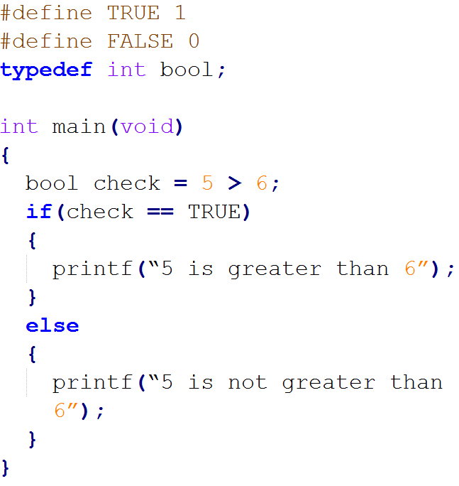
Creating a Boolean type

Slide 4
Structures
Arrays can be too limited
Only able to store 1 type
Sometimes want names for each item
Structures solve this
Can store any combination of types
Unique names for each item

Slide 5
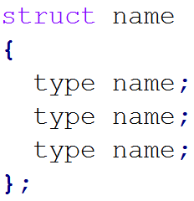
Defining a Struct
Must be defined before being used
Must be defined outside of your functions

Slide 6
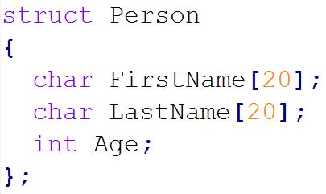
A Person Struct - Example

Slide 7
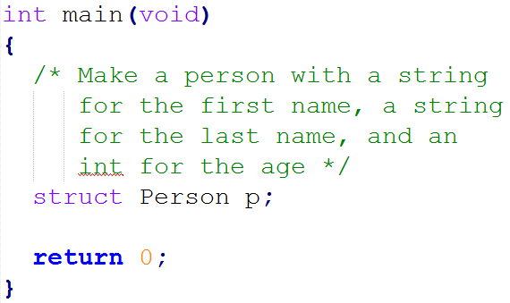
Making A Person Variable

Slide 8
Can Also Initialize Structs
Like initializing arrays
Must match order of variables in struct
For our Person struct:

Slide 9

Getting At The Data
When you make a struct variable you need to get at the data
Access the data by the variable name, then a period, then the data name:
For our Person struct:

Slide 10
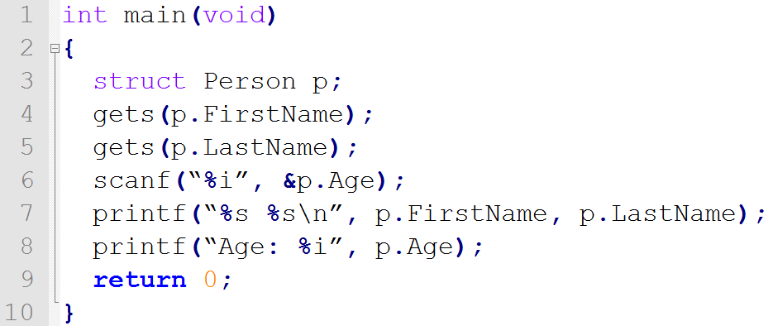
A Full Example

Slide 11



Pointers To Structs
Can make pointers to structs
Getting at the data gets messy
Can use the arrow operator instead: ->

Slide 12
More Shortcuts
We have to say struct a lot
When defining the struct
Creating a struct variable
Creating a pointer to a struct
struct parameters
Lets typedef it!

Slide 13
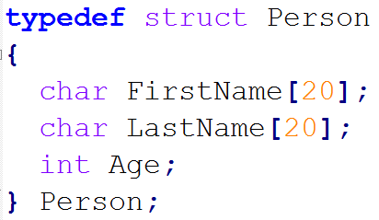
typedef struct

Slide 14
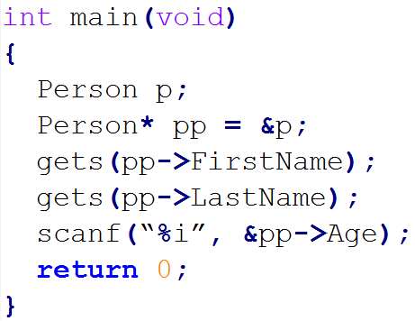
Using typedef struct
Notice how we never used struct before Person

Slide 15
Summary
We create our own types using structs
Access the variables in the struct with the . operator
Or the -> operator if it’s a pointer to a struct
Can typedef structs to make them easier to read/type

